Slide 1


Slide 2

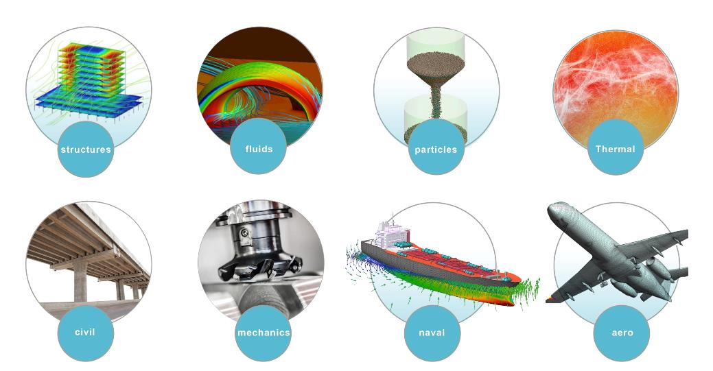
EXPERTS IN…
Research
Education
Dissemination
Technology Transfer
IN THE FIELD OF COMPUTATIONAL ENGINEERING

Slide 3
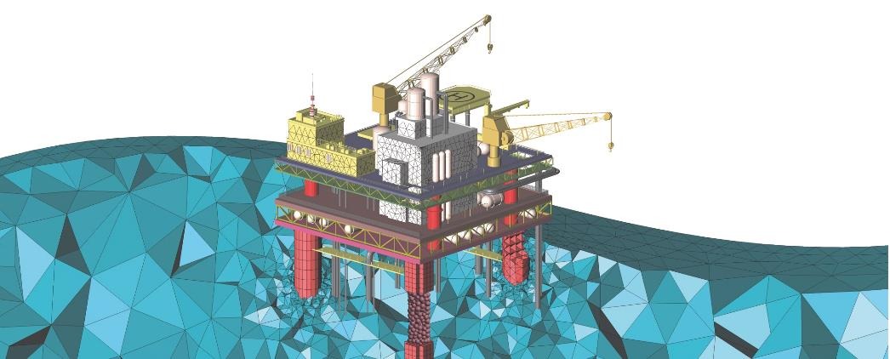

CIMNE is a R+D center in computational mechanics created in 1987, with a strong focus on research, knowledge transfer, dissemination and application of numerical methods in engineering.
KNOW MORE ABOUT
CIMNE’s MISSION

Slide 4
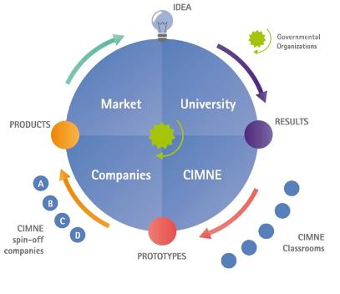
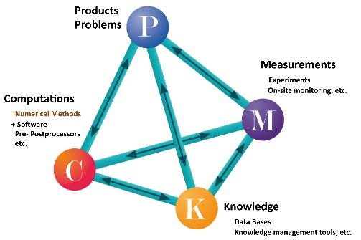
RESEARCH in cimne:
From the idea to the market
FURTHER INFO
THE CYCLE OF IDEAS
HOLISTIC VIEW OF RTD ACTIVITIES

Slide 5
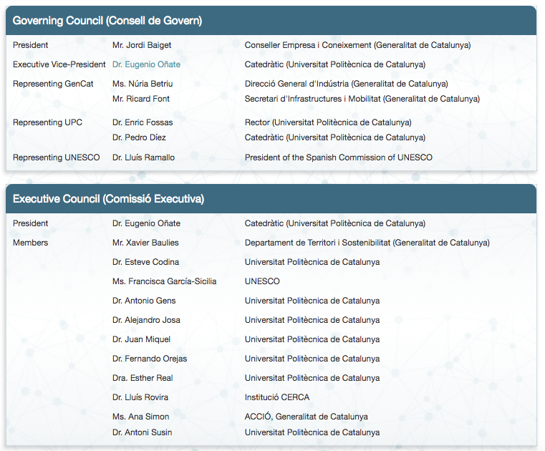
GOVERNING BODIES

Slide 6
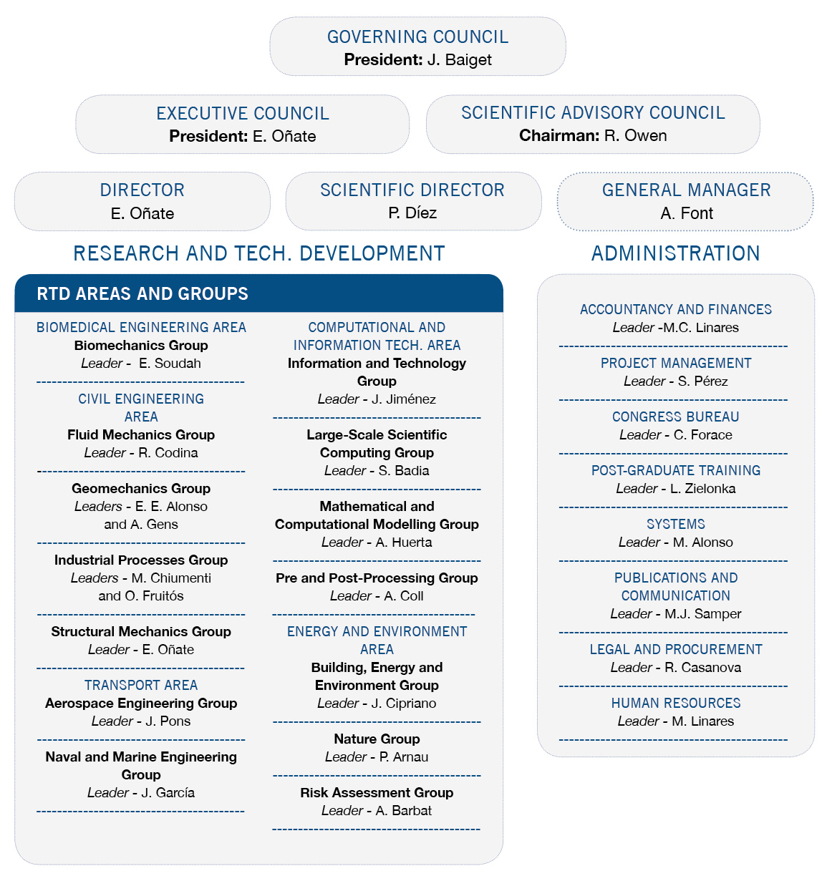
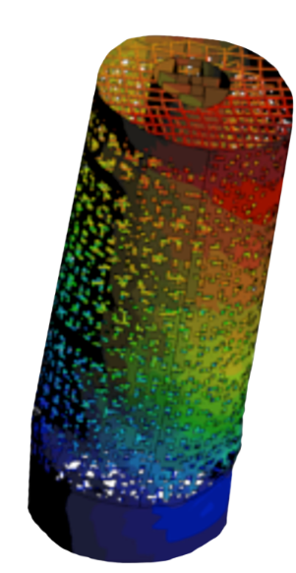

ORGANIZATION CHART

Slide 7
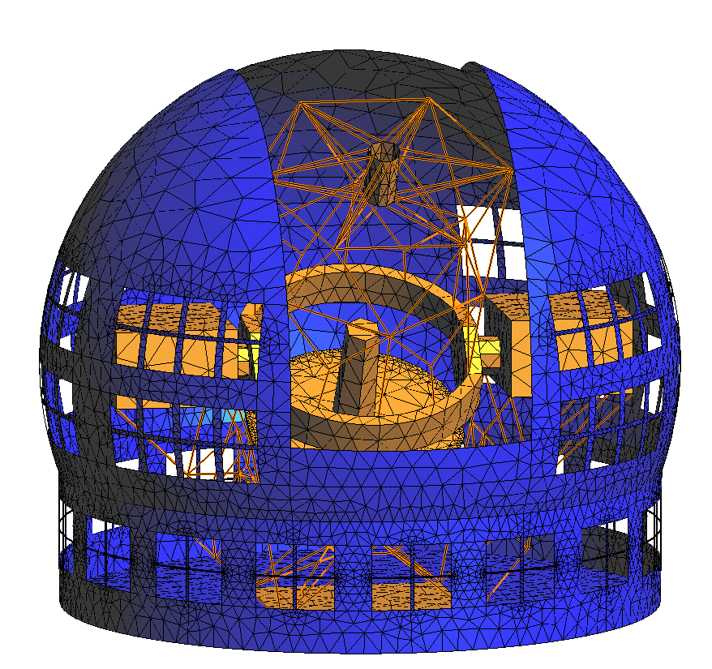
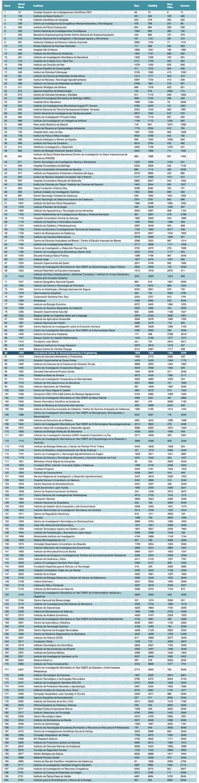
CIMNE RANKINGS
FURTHER INFO
In the world ranking, CIMNE is in the 1458th position in a list of 7953 research centers worldwide in production and scientific activities.
CIMNE is ranked in the 90th position on a list of 511 research centers in Spain in terms of production and scientific activities.
Sorted by the number of papers and citations for each academic domain, CIMNE is positioned at number 427 in the world (based on the database of Google Scholar Citations -GSC-).
Information at April 2017
Source: Webometrics

Slide 8
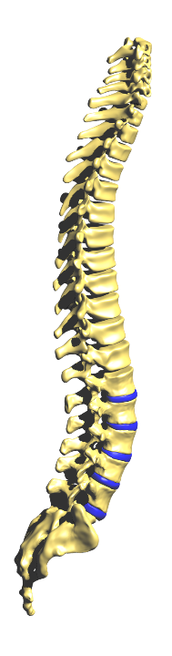
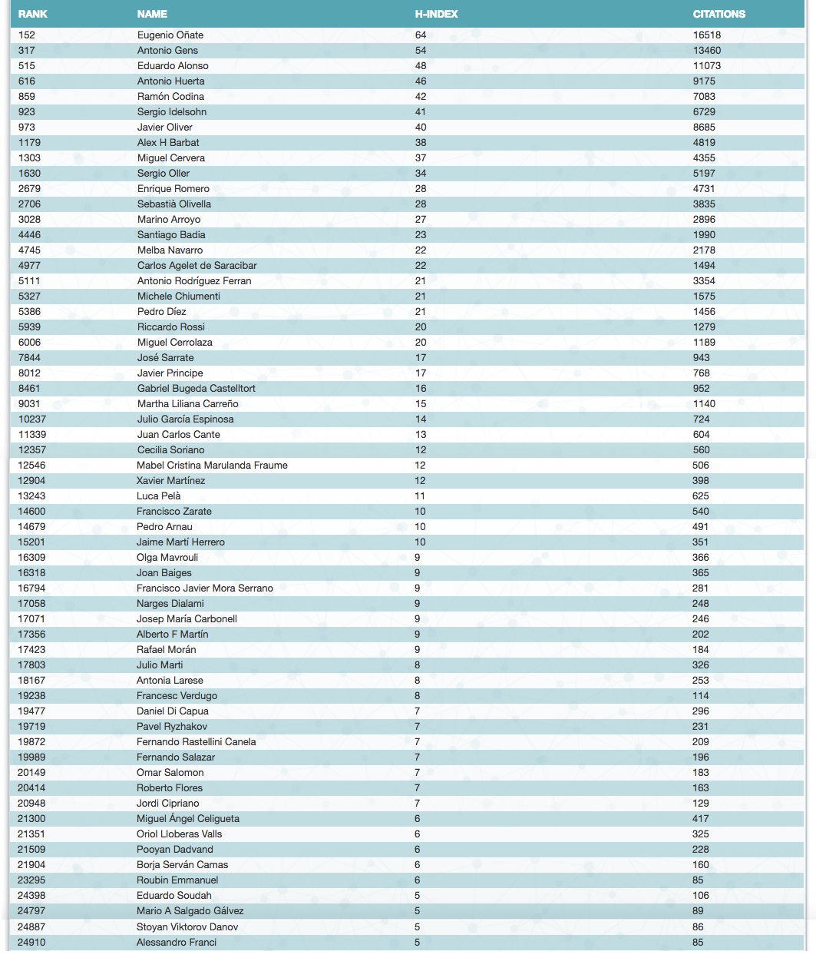
In April 2017, Webometrics has published a list of the most cited Spanish scientists. The study, based on citations from Google Scholar, includes 60 researchers of CIMNE among the 29,038 most cited scientists of Spain.
Information at April 2017
Source: Webometrics

Slide 9
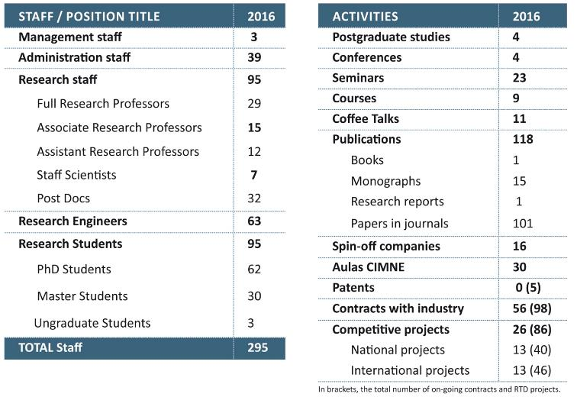
CIMNE IN NUMBERS
More than 200 scientists work at CIMNE.
29 researchers of CIMNE are faculty of the UPC BarcelonaTech.

Slide 10
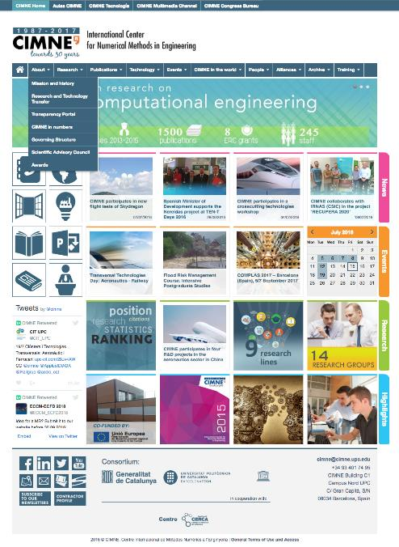
Nav bar with quick links to the main microsites of CIMNE.
Dropdown menu divided in ten sections to compile all the information about the center and its research activity worldwide.
CIMNE
WEBSITE
Tool
Bar /Quick links
Modules divided by content: News (last information about the center’s activity), Events (programme of congresses and scientific meeting organized by CIMNE or those where it participates), Research (facts, figures, projects and research structure of CIMNE), Highlights (other important informations about the center).
Activity feed of Twitter
Footer with the social networks, contractor profile, logos of the consortium, contact information and copyright.

Slide 11
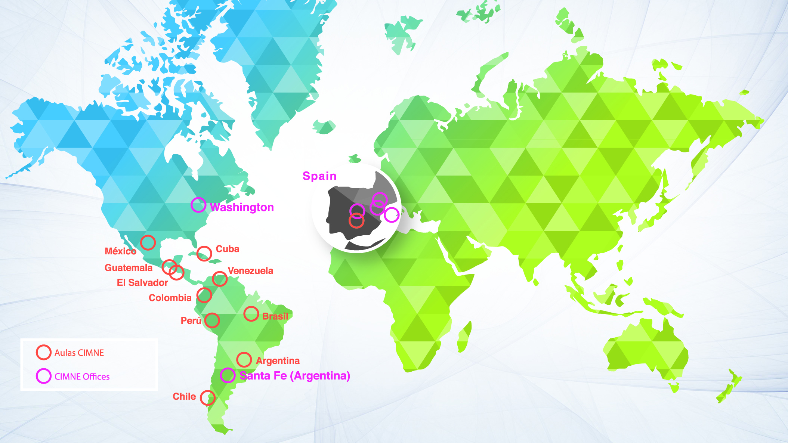
CIMNE IN THE WORLD

Slide 12
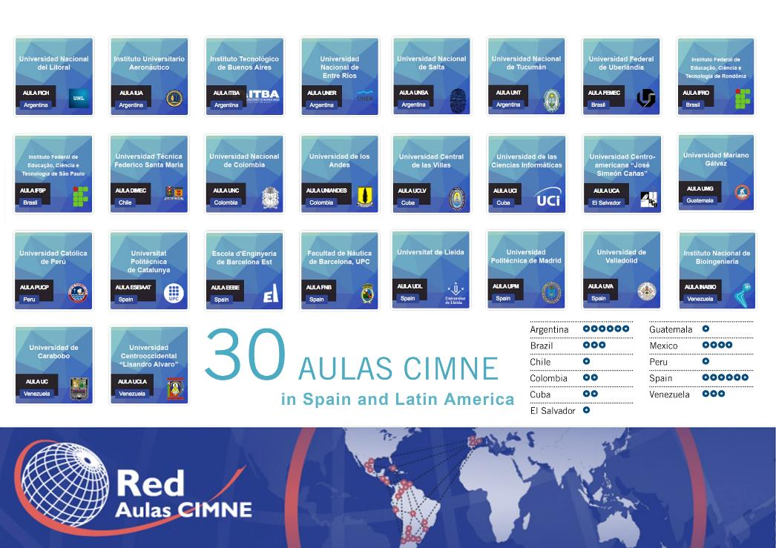

Slide 13
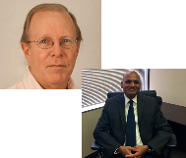
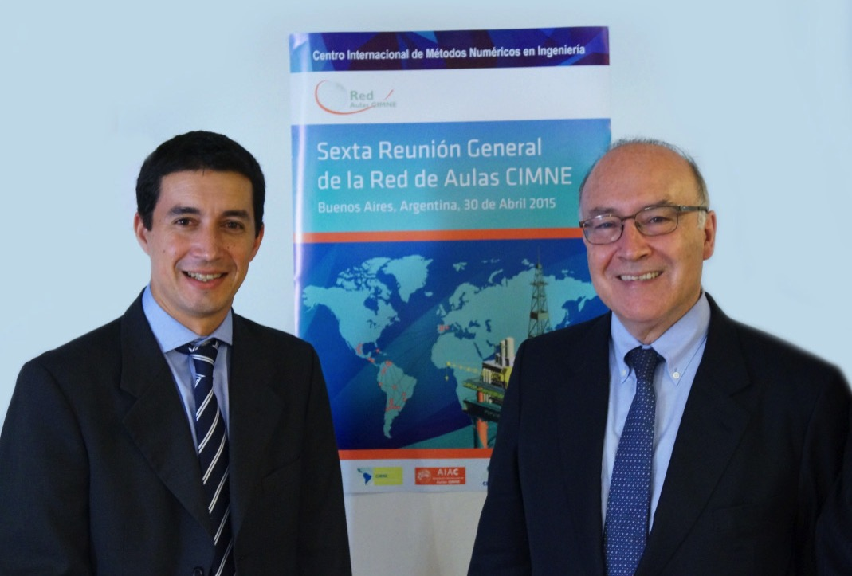
Cimne International branches
USA
CIMNE has promoted the creation of a non-profit corporation CIMNE-USA with the aim of fostering the scientific and technological activities of CIMNE in the US in cooperation with universities, research centers and enterprises in that country.
Dr. David Cranmer, CIMNE US Acting Executive Director, is a senior scientist at the National Institute of Standards and Technology (NIST) and advisor of many US companies. Mr. Varadaraju (Raju) Gandikota has recently been appointed CIMNE US Scientific Director.
Coordinator: Ms. Francisca García-Sicilia.
^{www.cimne.com/usa}
LATIN AMERICA
The formal establishment of CIMNE in Latin America has been initiated by creating a Foundation to foster the activity of CIMNE in that region.
CIMNE-Latin American Foundation (FCL) is located in the city of Santa Fe (Argentina), the place where the first CIMNE Classroom in the Latin America was created in cooperation with the University of Litoral.
Coordinator: Mr. Javier Piazzese.
^{www.cimne.com/fcl}

Slide 14
Cimne ACTIVITIES IN ASIA PACIFIC
CHINA
SINGAPORE
For more than 10 years, CIMNE has been collaborating with the People’s Republic of China in a number of fruitful cooperation agreements, RTD projects and some educational activities.
CIMNE has strong links with the most renowned scientific institutions in China, such as Peking University, Tsinghua University and several research centres of the Chinese Academy of Sciences or the Chinese Aeronautics Establishment.
Supported by the 6th and 7th Framework Programme and the Horizon 2020 of the European Union, CIMNE has carried out the coordination on the European side of a series of projects aimed at promoting joint EU-China research in aeronautics. CIMNE also participates in research projects in areas of risk assessment of natural disasters.
CIMNE has collaborated for many years with Singaporean entities in the field of biomedicine, energy and marine engineering.
The most outstanding example of research collaboration with Singaporean institutions is the study carried out in cooperation with the Tan Tock Seng Hospital and NTU on mechanistic and pathology of the genesis, growth, and rupture of abdominal aortic aneurysms.

Slide 15
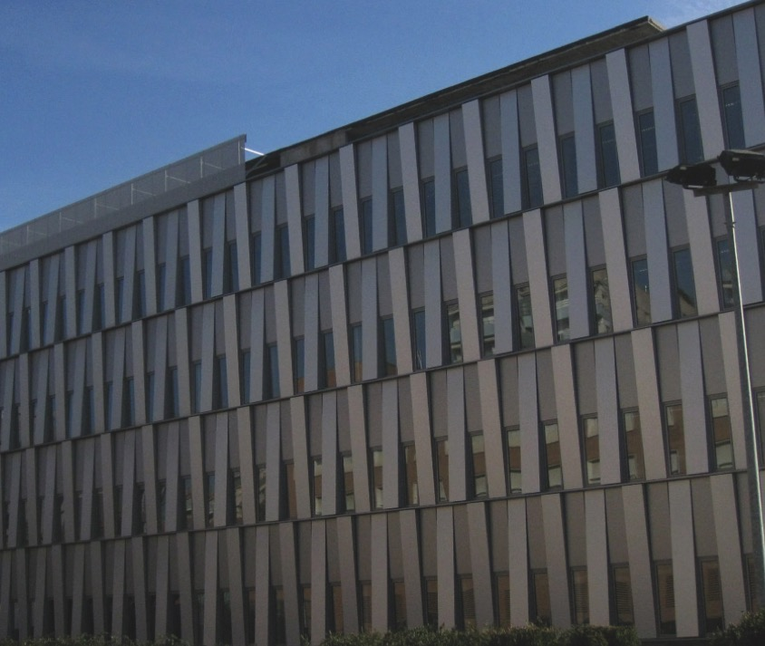
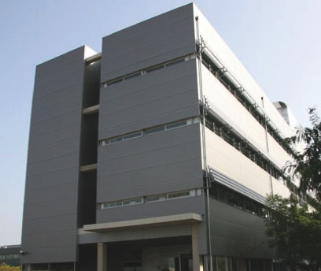
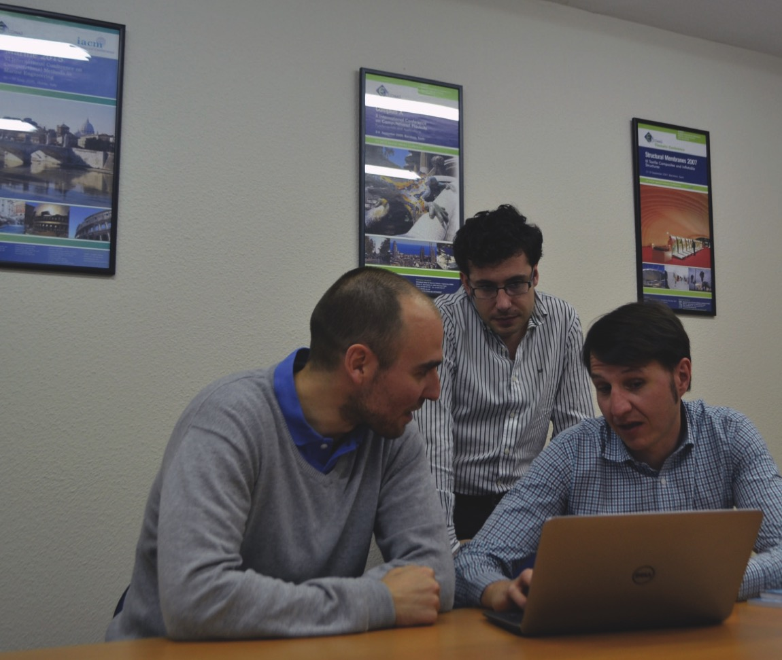
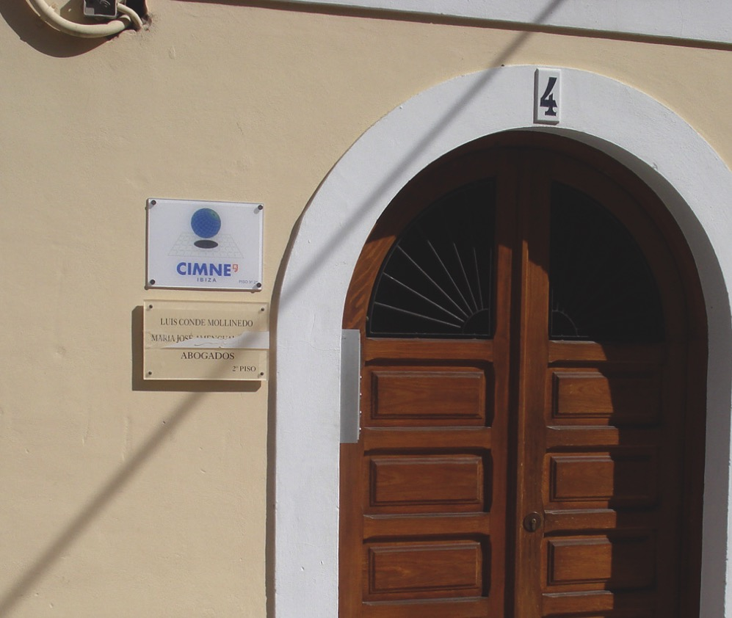
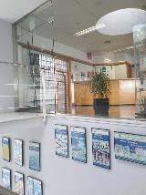
Premises in spain
BARCELONA
TERRASSA
CASTELLDEFELS
MADRID
IBIZA
CIMNE’s offices in Terrassa opened in 2001. The premises cover an area of 150m2 and house part of the department of Building Energy and Environment Group (BeeGroup).
J. Cipriano
Campus de Terrassa UPC
Edifici GAIA (TR14)
C/ Rambla Sant Nebridi, 22
08222 Terrassa (Barcelona), Spain
+34 93 789 91 69
CIMNE’s headquarters in Castelldefels were inaugurated on October 15th 2008. The facilities are located in the building CIMNE-C3 of the Mediterranean Technology Park, and occupy 1,500m2 in a new building constructed in collaboration with the UPC. The premises are shared with the Technical School of Castelldefels.
J. Mora
Campus del Baix Llobregat UPC
CIMNE Building C3
C/Esteve Terradas, 5
08860 Castelldefels, Barcelona, Spain
+34 93 413 41 86), Spain
+34 93 789 91 69
CIMNE - MADRID started its activities in September 2007 and on May 2008 CIMNE opened its premises located in the center of the city (150m2). The main goal of CIMNE Madrid is to build a strong research team in Madrid and foster the links between CIMNE, the Central Government of Spain and partner companies and research centers based in Madrid.
F. Salazar
Paseo General Martínez Campos, 41, 9º, 28010 Madrid, Spain
Tel. +34 91 319 13 59
+34 93 789 91 69
CIMNE inaugurated the CIMNE - IBIZA branch in 2009. It has 80m2 and is located in the city of Ibiza.
The main line of research of the branch is environmental acoustics, developing new algorithms to be used to study the propagation of environmental noise with applications to noise mapping.
G. Molina
C/Bisbe Azara, 4, 3º 2ª
07800 Ibiza, Spain
Tel. +34 97 193 11
CIMNE’s main premises are located at the heart of the North Campus of UPC. The offices, situated at the C1 Building, occupy some 1,000 m2. Also, in July 2016 was inaugurated the B0 building, that hosts the Flumen Institute and provides work areas for CIMNE and UPC researchers.
A. Font
Campus Nord UPC, CIMNE Building C1
C/ Gran Capità, S/N, 08034 Barcelona, Spain
+34 93 401 74 95

Slide 16




Scientific societies
Sociedad Española de Métodos Numéricos en Ingeniería
CIMNE holds the General Secretariat of the Spanish Association for Numerical Methods in Engineering.
International Association For Computational Mechanics
CIMNE holds the General Secretariat of the International Association for Computational Mechanics.
European Community on Computational Methods in Applied Sciences
CIMNE holds the Secretariat of the European Community on Computational Methods in Applied Sciences.
European Research Community On Flow, Turbulence And Combustion
CIMNE is a Pilot Centre for the European Research Community in Flow, Turbulence and Combustion. ERCOFTAC Spanish Pilot Centre.
International Association of CIMNE Classrooms
The International Association of CIMNE Classrooms is a non-governmental civil non-profit organization which aims to promote the advancement of numerical methods in a common academic space.

Slide 17
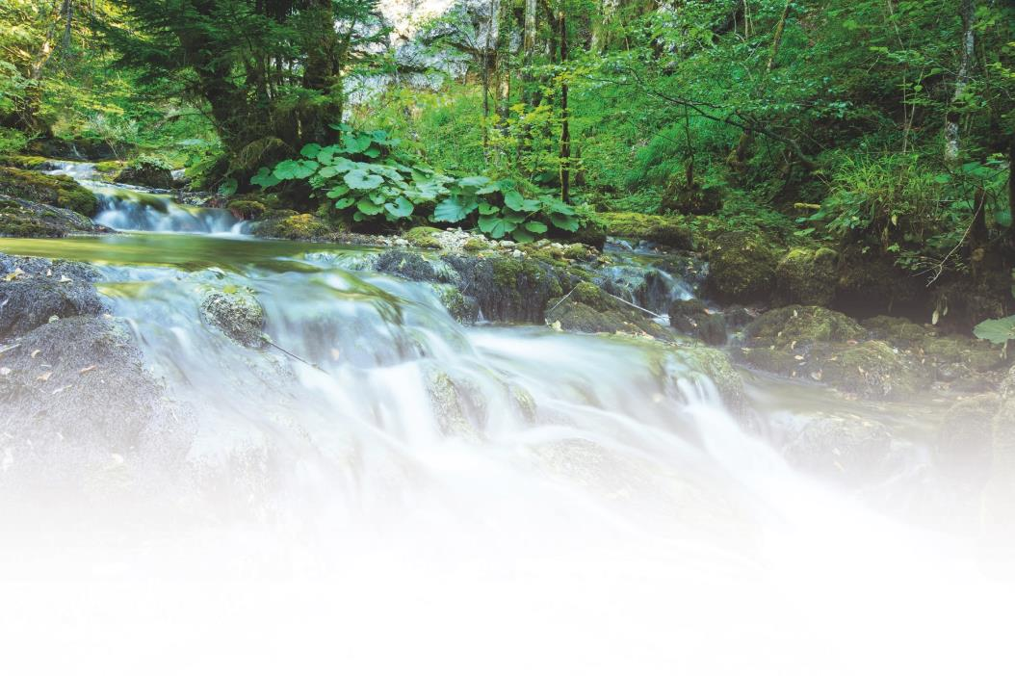
Alliances
In 2012, the Government of Catalunya created the FLUMEN Institute for River Dynamics and Hydrologic Engineering as a partnership between CIMNE and UPC · BarcelonaTech.
FLUMEN Institute merges the prestigious Flumen RTD group existing since 2005 at the School of Civil Engineering of UPC and CIMNE, bringing together the numerical and experimental expertise of Flumen RTD group in hydraulics with the broad experience of CIMNE on numerical methods.
The objectives of FLUMEN are the promotion of research and technology transfer activities in the field of river dynamics and hydrologic engineering. The Flumen Institute is directed by Prof. Josep Dolz.
MEMBERS

Slide 18
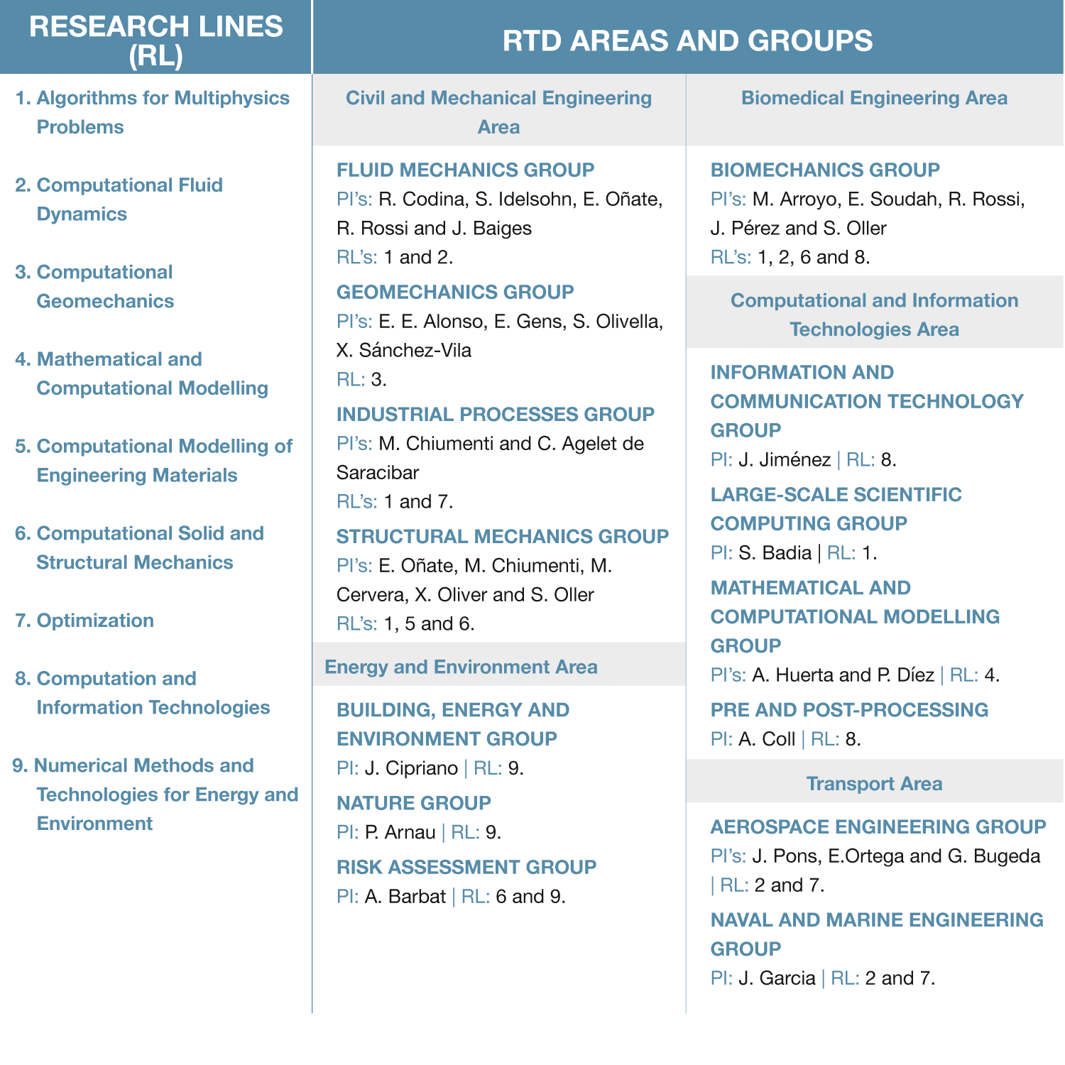
RESEARCH LINES, RTD AREAS AND GROUPS

Slide 19
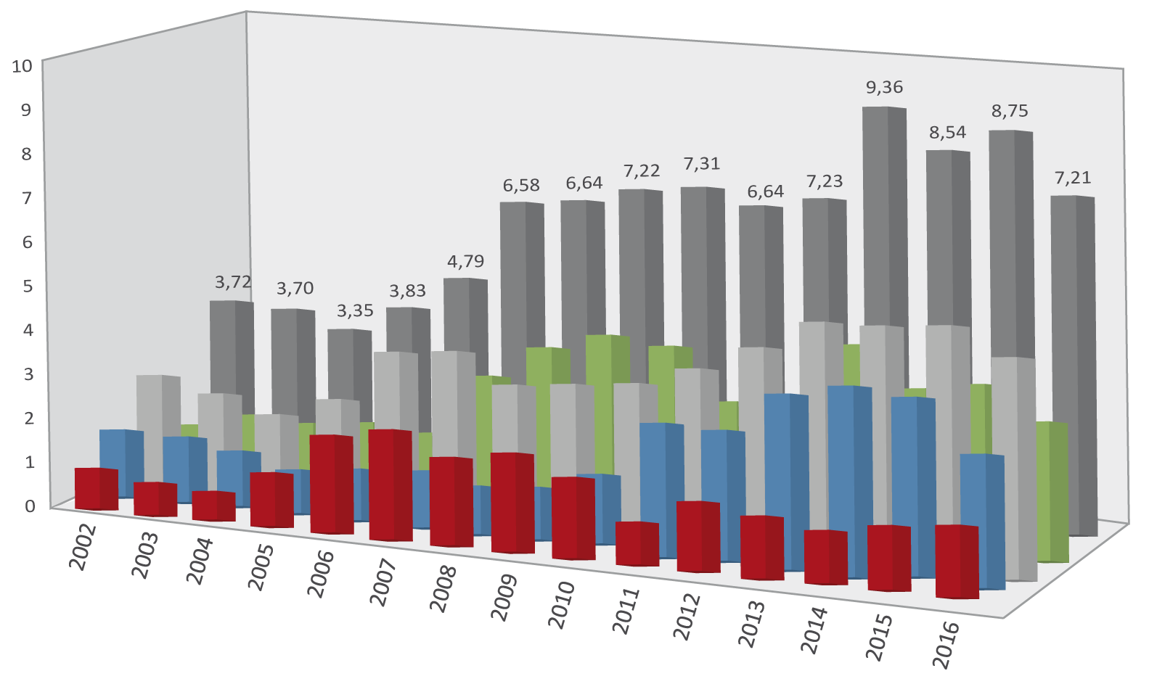
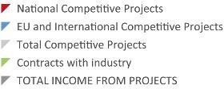
RTD projects
INCOME FROM RTD PROJECTS (2002-2016)
Information at 21/03/2017
More than 2,000 RTD projects in cooperation with some 600 companies since 1987
–In M€–
ON-GOING RTD PROJECTS:
National Projects: 40
International Projects: 46
Contracts with Industry: 98
TOTAL: 184
PAST PROJECTS
ON-GOING PROJECTS
MORE
GRAPHICS

Slide 20
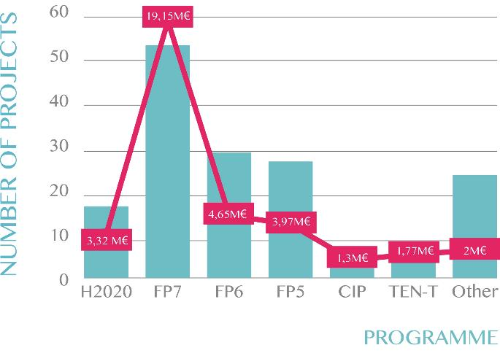
STATISTICS OF EC PROJECTS
NUMBER OF PROJECTS AND CIMNE FUNDING

Slide 21
Relevant RTD projects
ADVANCED GRANTS
COMP-DES-MAT (2013/18): Advanced tools for computational design of engineering materials. Prof. Javier Oliver
SAFECON (2011/15): New Computational Methods for Predicting the security of constructions to Water Hazards accounting for fluid-soil-structure interactions. Prof. Eugenio Oñate
REALTIME (2009/14): Real Time Computational Mechanics Techniques for Multi-Fluid Problems. Prof. Sergio Idelsohn
STARTING GRANTS
COMFUS (2011/15): Computational Methods for Fusion Technology. Prof. Santiago Badia
PROOFS OF CONCEPT
ICEBREAKER (2016/17): Industrial applicability and potential for commercialization of the computational technology developed in SAFECON. Prof. Eugenio Oñate
NUWASIM (2016/18): On a Nuclear Waste Deep Repository Simulator. Prof. Santiago Badia
FLOODSAFE (2015/16): Asessment and initial steps for the exploitation of a simulation software for the study and mitigation of the effect of floods on constructions and landscape. Prof. Eugenio Oñate
FORECAST (2015/16): Assessment and initial steps for the exploitation of a fast simulation software for casting manufacturing operations. Prof. Sergio Idelsohn
FEXFEM (2015/16): On a free open source extreme scale finite element software. Prof. Santiago Badia
European Research Council
GRANTS

Slide 22
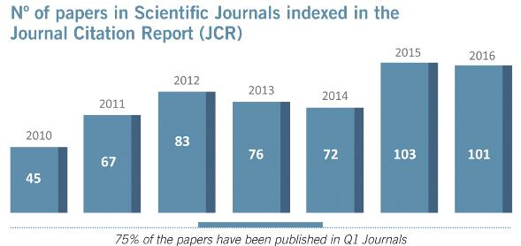
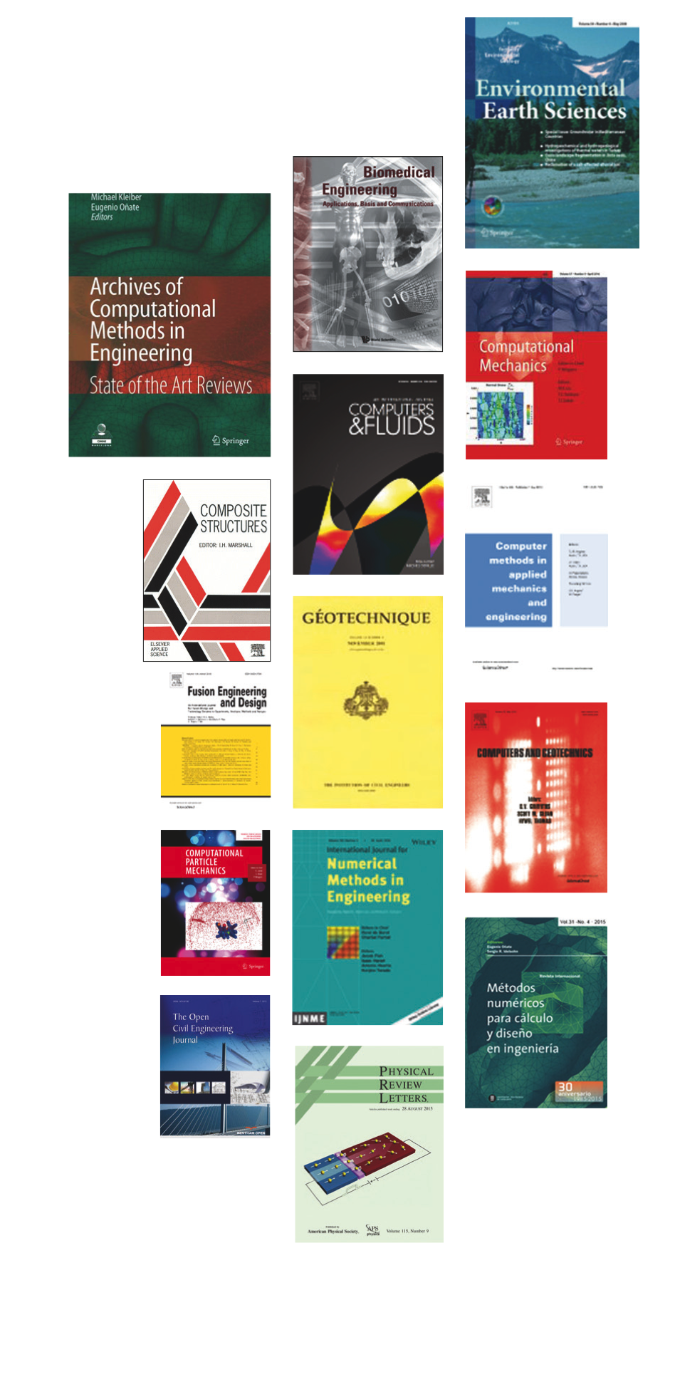
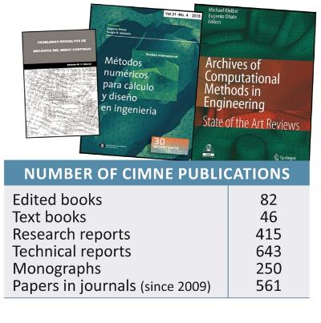
publications
More than 1,400 publications since 1987

Slide 23
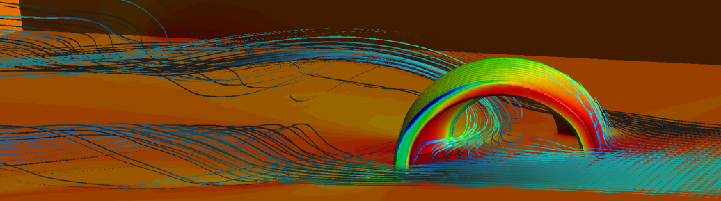
TECHNOLOGY TRANSFER
A vocation for Technology Transfer since 1987.
Creation of CIMNE Tecnología, SA. (2011), a company 100% owned by CIMNE, in charge of the technology transfer of CIMNE outputs.
16 spin-off companies.
PRODUCTS
SPIN-OFF
COMPANIES
CIMNE
TECNOLOGÍA

Slide 24
















16 SPIN-OFF COMPANIES
Created in 2001
Created in 2002
Created in 2006
SOLUCIONES INTEGRALES DE FORMACIÓN Y GESTIÓN STRUCTURALIA, SA
COMPASS INGENIERÍA Y SISTEMAS, SA
INGENIA IAE
BEFORE 2011
It promotes the participation of its members in projects of aeronautics and the space field.
It is formed by several companies and CIMNE.
CIMNE TECNOLOGÍA
Applications of numerical methods in civil, naval and maritime engineering.
CIMNE owns 24% of COMPASS.
E-Training and consulting activities in civil engineering. It was sold in 2011 to The Washington Post Group.
Created in 2011, the company is owned by CIMNE aiming to industrialize and market the outputs of CIMNE research.
BIOMECHANICS DEVELOPMENTS, SL
BUILDAIR INGENERÍA Y ARQUITECTURA, SA
COMPUTATIONAL AND INFORMATION TECHNOLOGIES, SA
FRESH WATER NATURE, SL
HEALTHAPP, SL
Software solutions and services in biomedical field.
50% owned by CIMNE Tecnología.
Inflatables structures for engineering and architecture applications.
5% owned by CIMNE Tecnología.
Computational methods and information technology systems in engineering.
100% owned by CIMNE Tecnología.
Solutions for obtaining fresh water from desalination and destillation of waste water.
100% owned by CIMNE Tecnología.
Software to treat eating disorders. It improves the links therapist / patient.
15% owned by CIMNE Tecnología.
PNEUMATIC STRUCTURES TECHNOLOGIES, SL
RSM GASSÓ CIMNE ENERGY, SL
INLOC ROBOTICS, SL
LYNCOS TECHNOLOGIES, SL
PORTABLE MULTIMEDIA SOLUTIONS, SL
Advanced engineering energy services. 50% owned by Servicios Energéticos Avanzados, which is 100% owned by CIMNE Tecnología.
Positioning and navigation solutions for mobile robots in buried environments.
5% owned by CIMNE Tecnología since 2015.
Software and systems for the Internet of Things.
15% owned by CIMNE Tecnología.
Mobile pavilions with multimedia technology for leisure, sport and events.
20% owned by CIMNE Tecnología.
Pneumatic structures for a wide range of engineering problems.
10% owned by CIMNE Tecnología.
TECNOLOGÍAS AVANZADAS PARA EL OCIO, SL
QUANTECH ATZ
SCIPEDIA, SL
Software for production processes. CIMNE Tecnología joined the company in 2015, with a share of 3,5%.
Free publishing and open access for scientific publications.
16,67% owned by CIMNE Tecnología.
Information systems for leisure sectors (tourism, music…).
100% owned by CIMNE Tecnología.

Slide 25

INTERNATIONAL events
A leader in international organization of scientific events on Computational Engineering.
CONGRESS
BUREAU
Organizer of 200 international events since 1987.

Slide 26
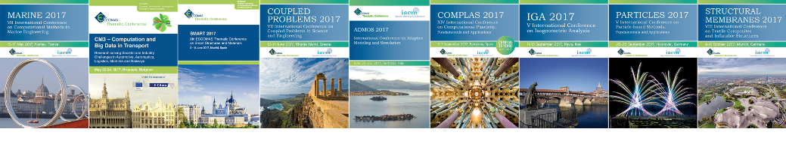






NEXT INTERNATIONAL events
ORGANIZED BY CIMNE CONGRESS BUREAU
RELEVANT CIMNE CONFERENCES 2017
MARINE
14/17 May 2017
CM3
22/24 May 2017
SMART
5/8 June 2017
COUPLED PROBLEMS 12/14 June 2017
ADMOS
26/28 June 2017
COMPLAS
5/7 Sept. 2017
IGA
11/13 Sept. 2017
PARTICLES 26/28 Sept. 2017
STRUCTURAL MEMBRANES 9/11 Oct 2017
OTHER INTERNATIONAL CIMNE CONFERENCES AND WORKSHOPS

Slide 27



SEMINARS and COFFEE TALKS
FURTHER INFO
In 2016, CIMNE has organized 23 seminars and 11 coffee talks on the theory and application of numerical methods in engineering.

Slide 28
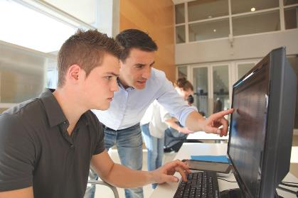




Post graduate studies
FURTHER INFO
CIMNE manages Masters courses and PhD programmes on Computational Engineering
in cooperation with international universities.
MASTER DEGREES
PhD DEGREES
Awarded by Universitat Politècnica de Catalunya (UPC)
Awarded by Universitat Politècnica de Catalunya (UPC)

Slide 29

www.cimne.com

