Slide 1

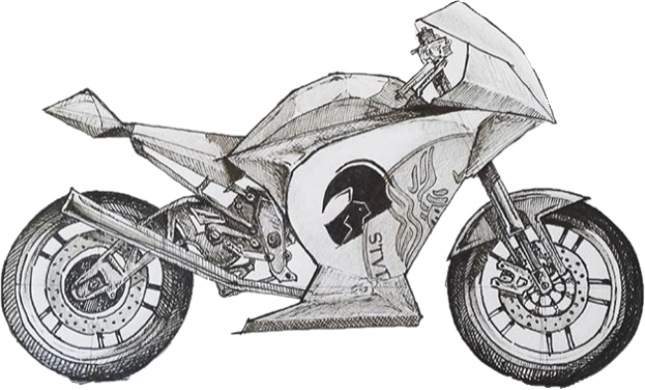
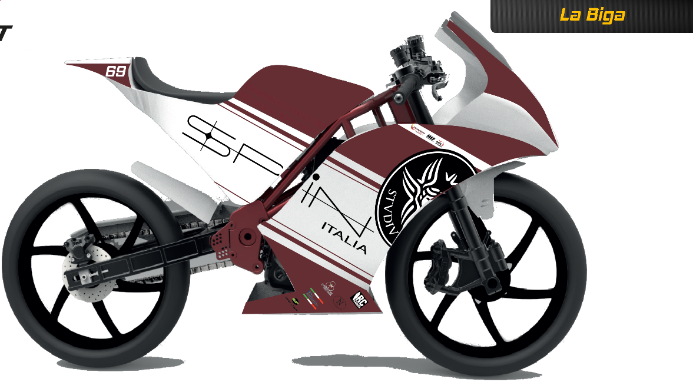
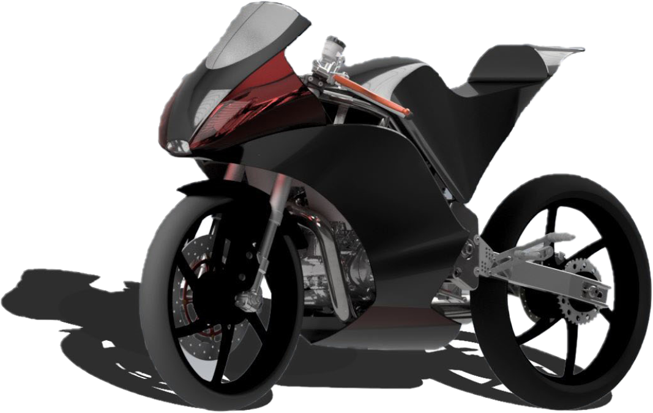


V Motostudent International Competition - Sapienza Gladiators Racing team – 2016/18
Optimization of the inlet system of a monocylindric 4-strokes engine in the project MotoStudent International Competition

Slide 2
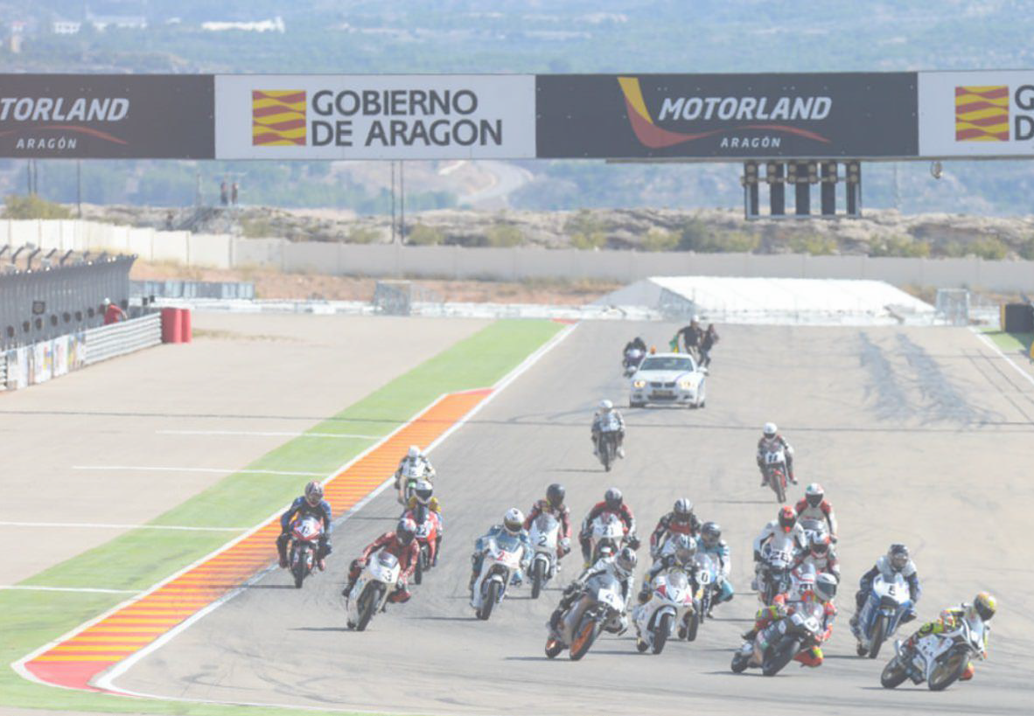
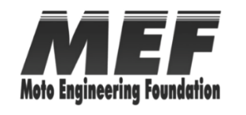



Moto Engineering Foundation & TechnoPark
MotorLand
V MOTOSTUDENT INTERNATIONAL COMPETITION – 2018 -
Apply
all the knowledge acquired during their university studies in a real industrial project
Designing, developing and manufacturing a real racing motorbike prototype, which will be evaluated and tested in Motorland Aragón FIM Circuit.
47 University Student teams among all over the world
goal
by

Slide 3
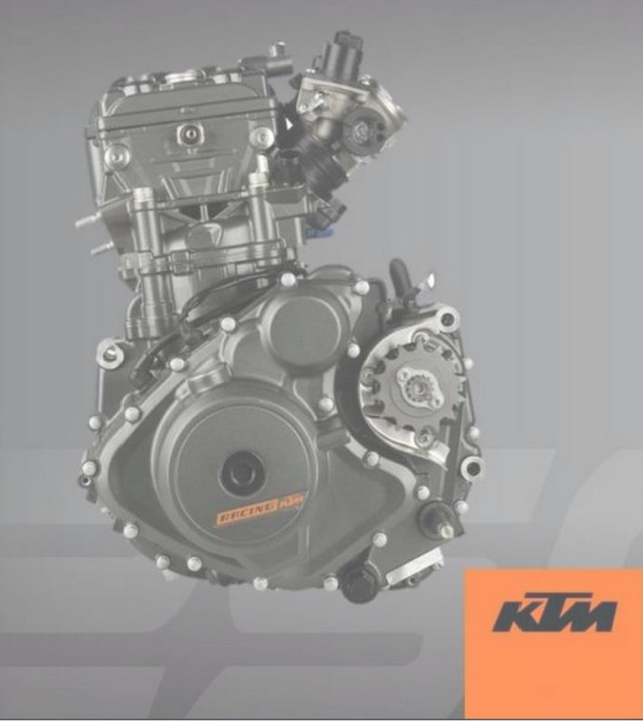
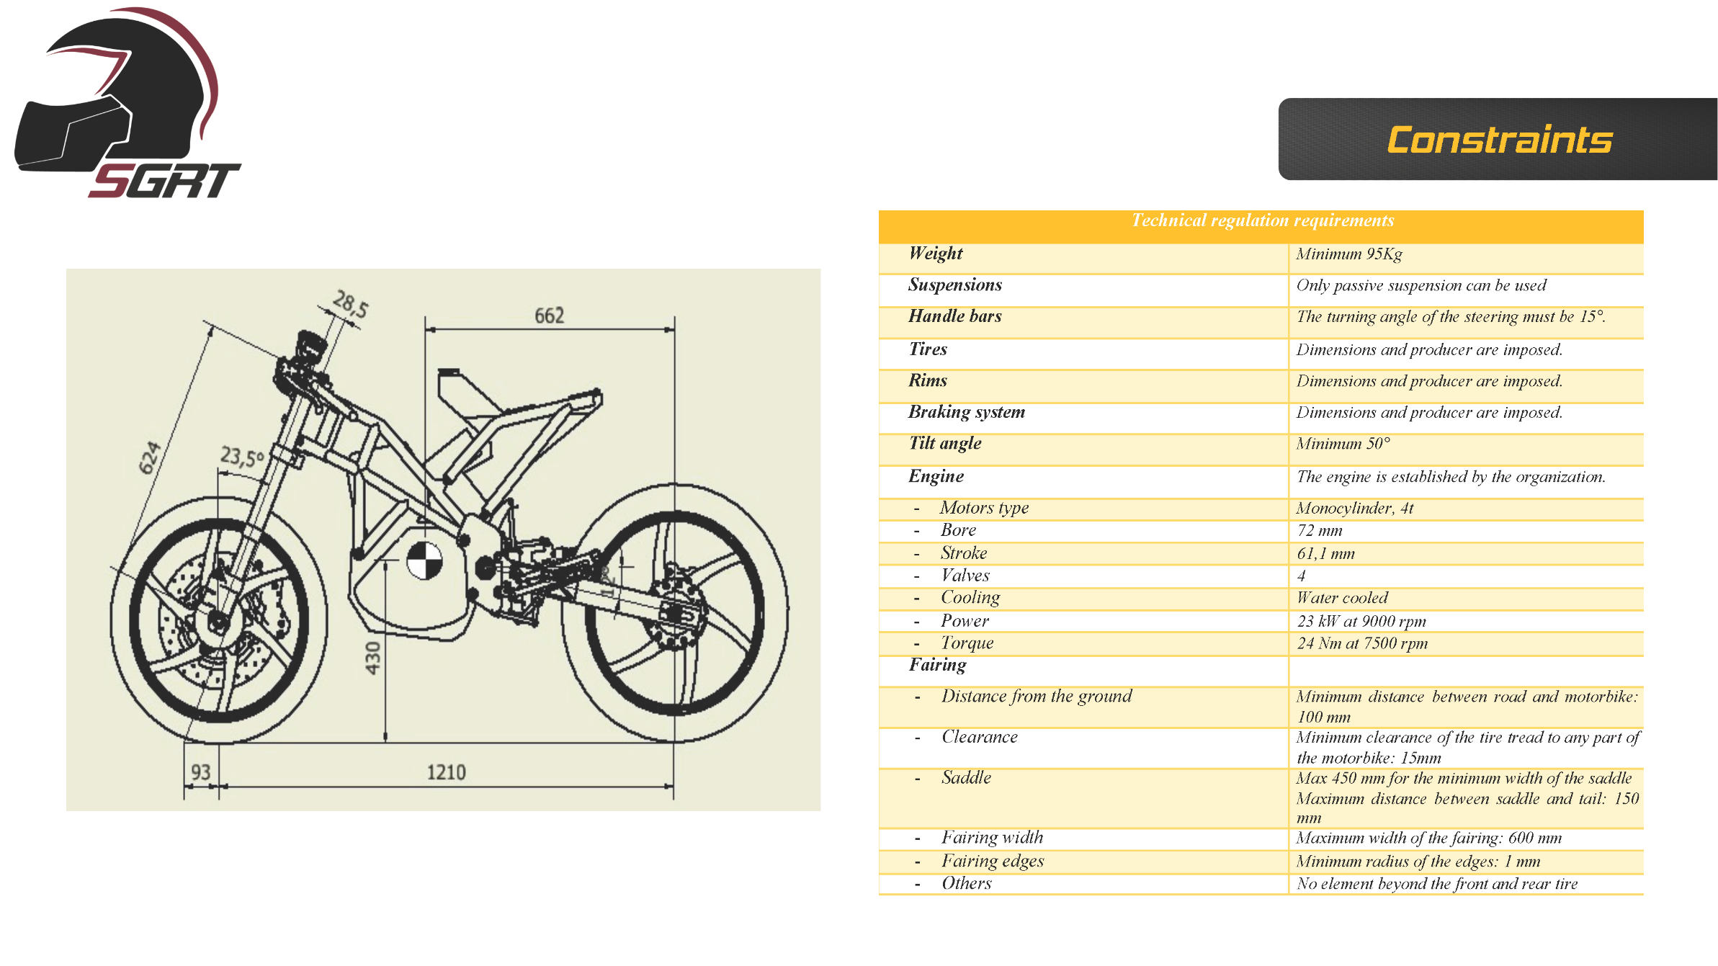
Motostudent kit
Constraints
The prototype must be equipped with the following mandatory components:
Engine: KTM RC 250 monocylinder 4T
Tyres: DUNLOP, Front 90/70 R17, Rear 115/70 R17
Rims: OZ da 17”
Braking system: J. Juan, radial calipers and brake master cylinder

Slide 4
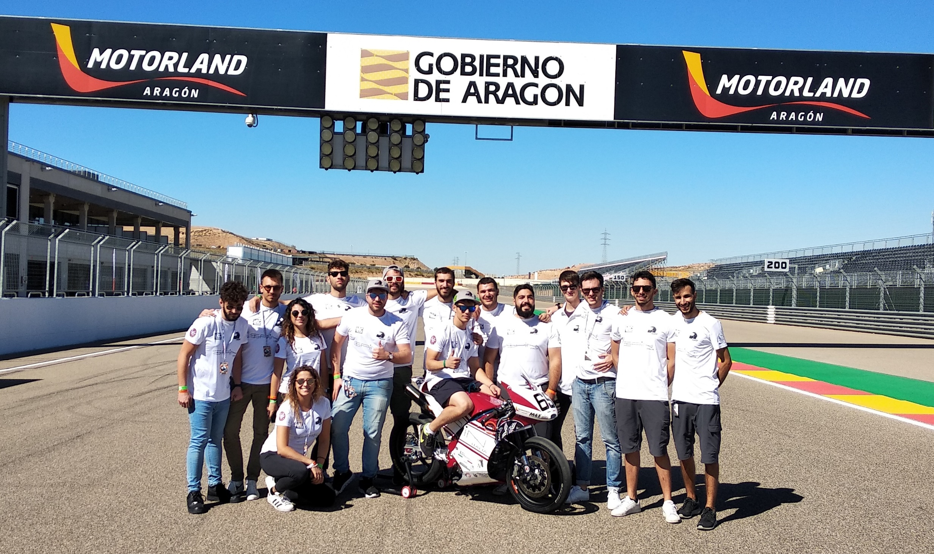
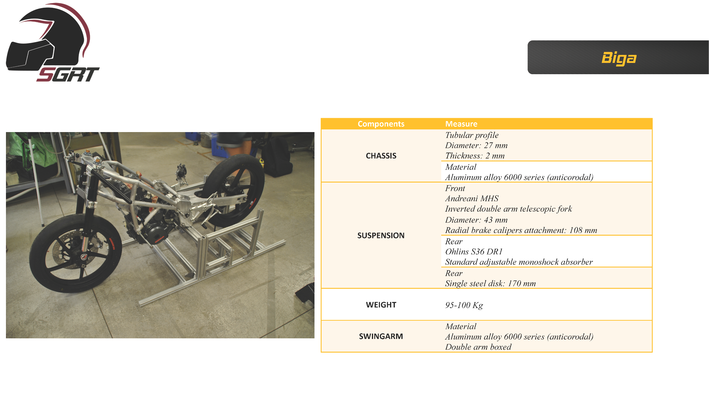
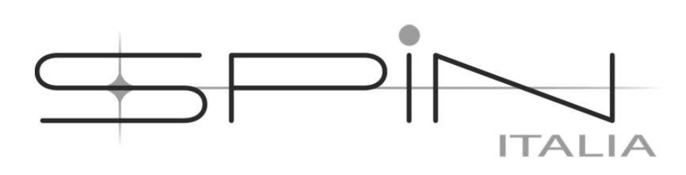



Sapienza Gladiators Racing Team
The team is formed by 18 students, divided in five different units: Chassis, Engine, Aerodynamics, Electronics and Operations.
The academic coordinator is Antonio Carcaterra, full professor at the Mechanical and Aerospace department in Sapienza and president of Sapienza Innovazione.
Foto del team
Biga

Slide 5
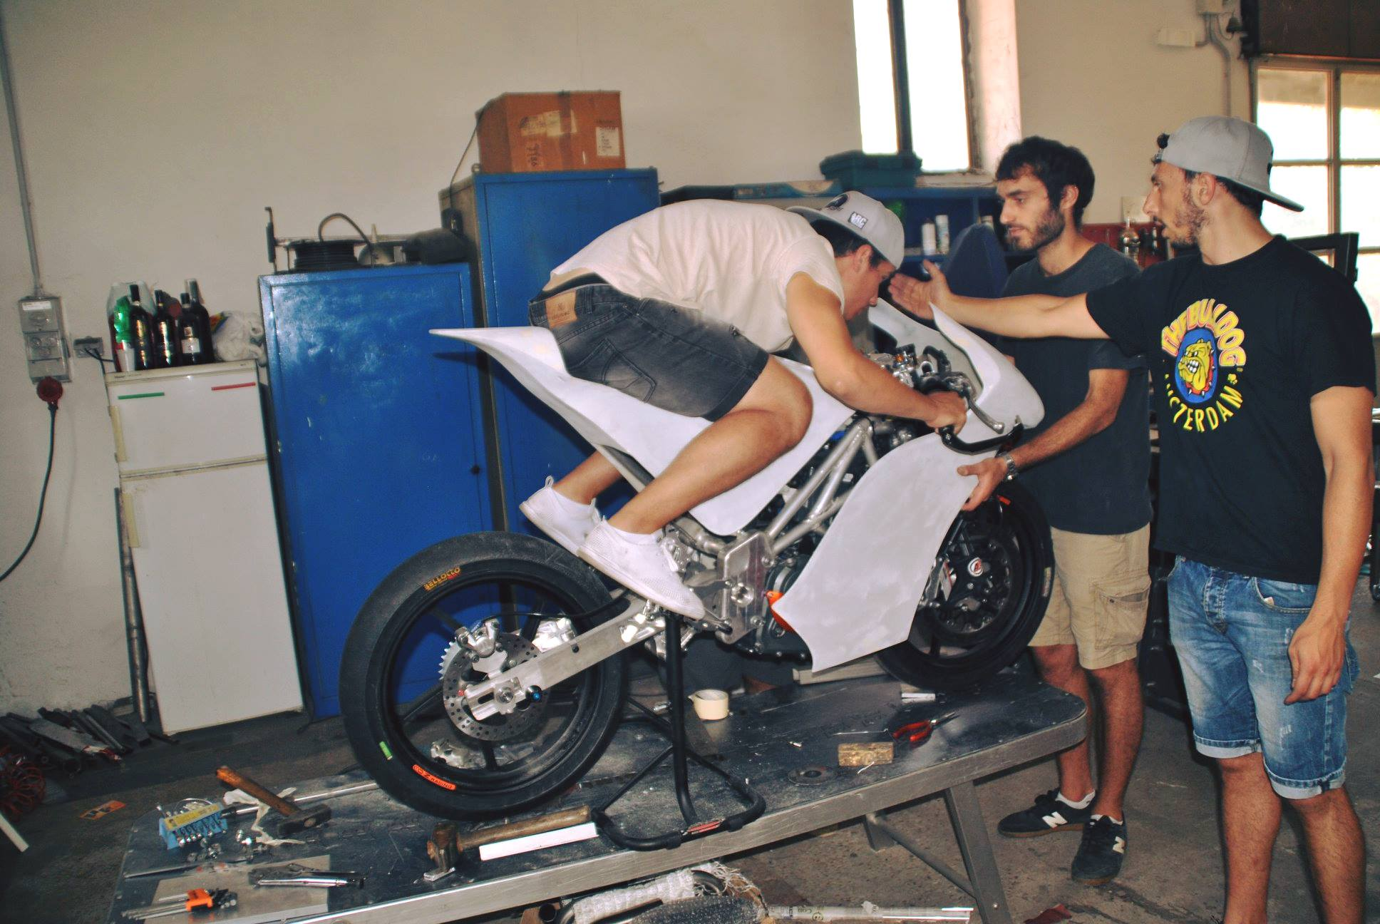
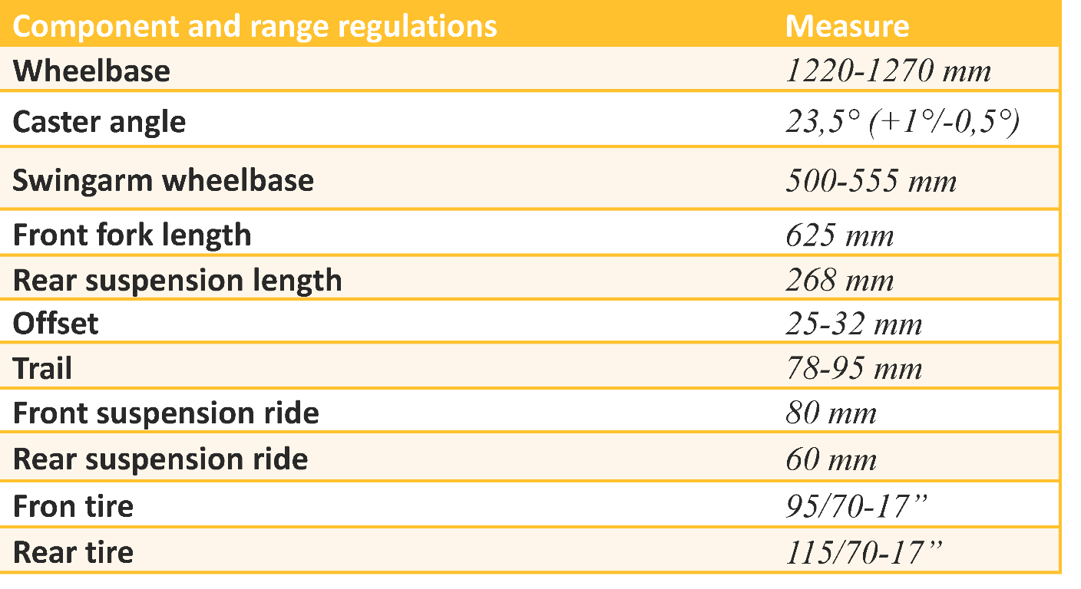
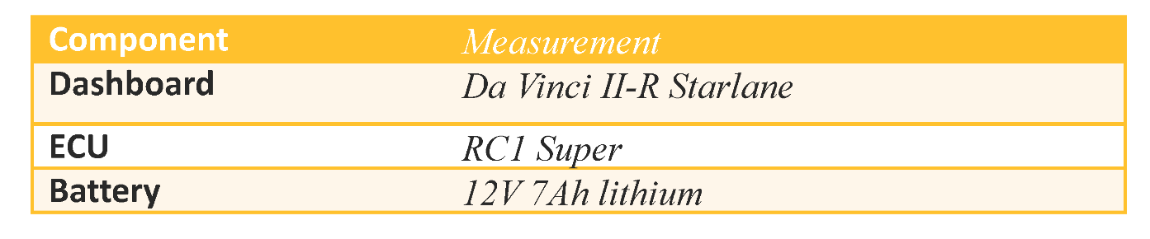


Biga

Slide 6

The Inlet system
Effective power
Volume - Pressure
Otto combustion cycle

Slide 7
Air as a damper spring mass system
Inlet Pipe

Slide 8
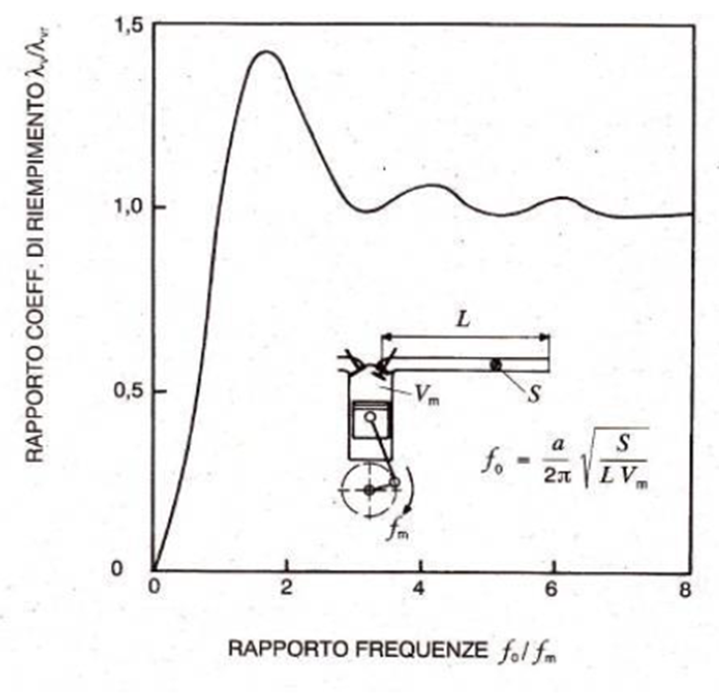

How maximise λ
Find optimal length and section for the inlet pipe
Filling coefficient
Pressure on the valve – Crank angle
λ - frequency

Slide 9
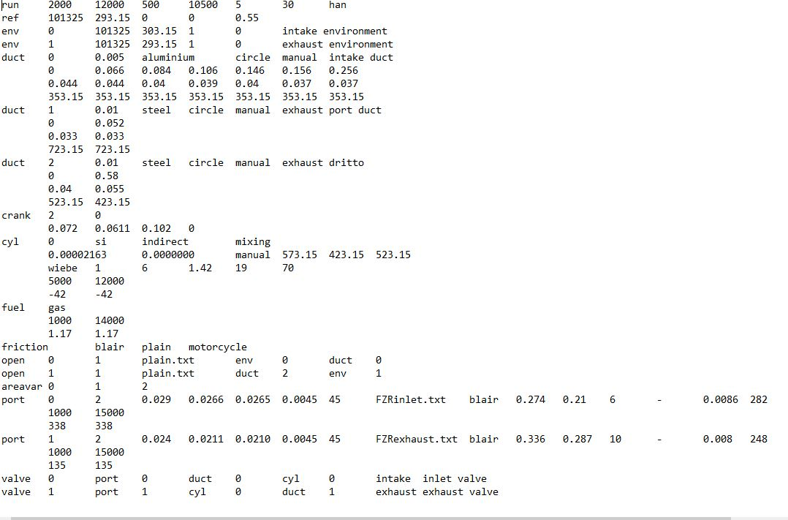
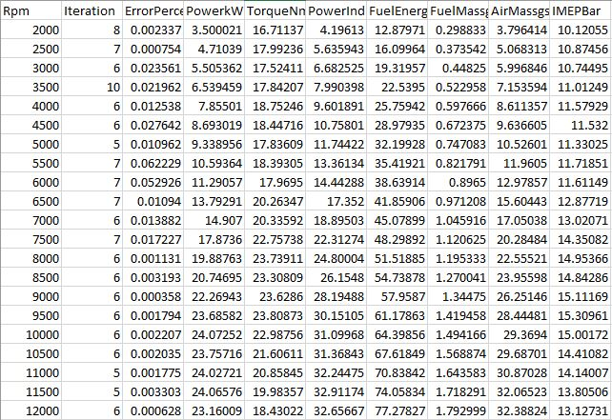
Enginesym
Input file
Output file

Slide 10
Enginesym results
Bench test results

Slide 11
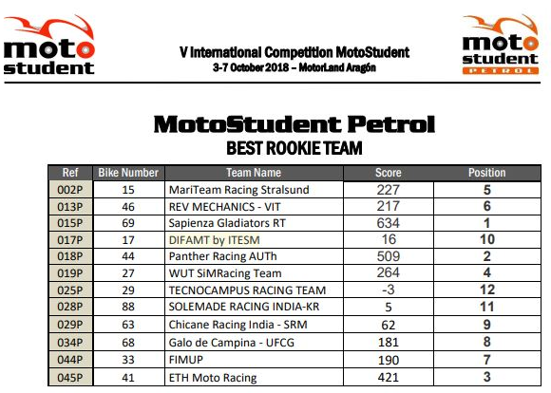
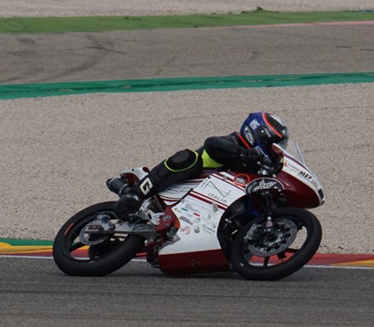
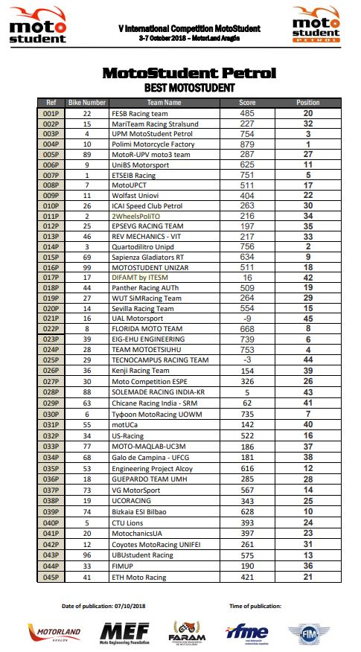
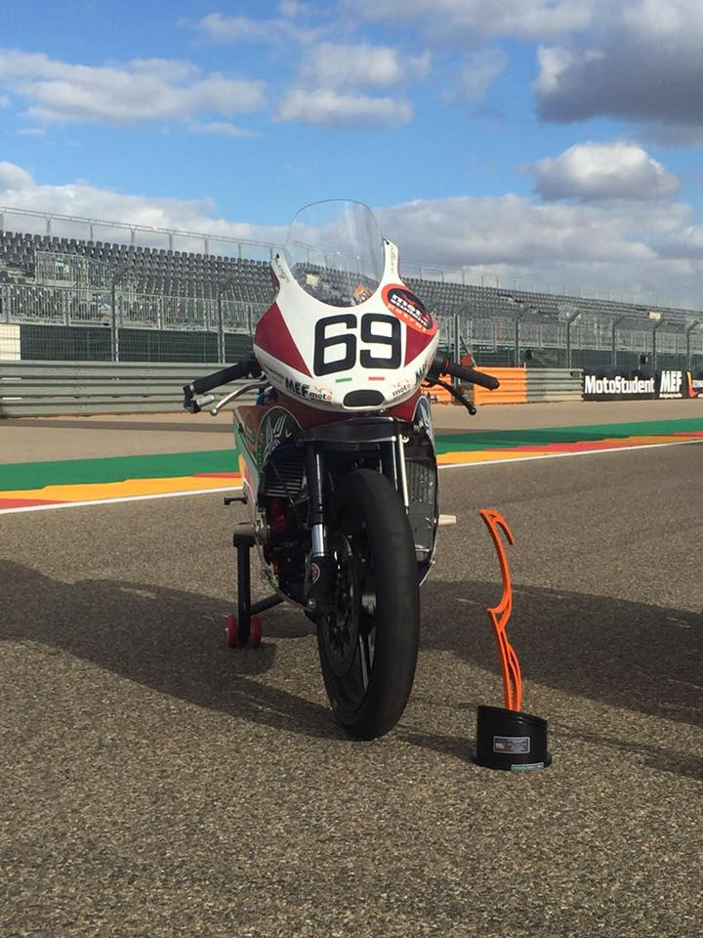
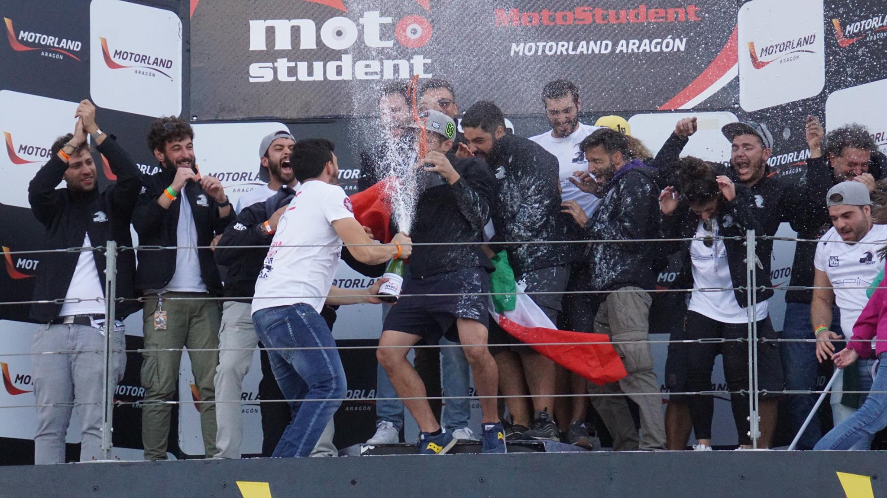
The race – Aragon Motorland – 07/10/2018
World’s Best Rookie Team 2018
9° place overall

Slide 12







Our Sponsor
Thank you

Slide 13
References
Fondamenti di Meccanica Teorica e Applicata, N. Bachschmid, S. Bruni, A. Collina, B. Pizzigoni, F. Resta, A. Zasso
Motori a Combustione Interna, G. Ferrari
Internal Combustion Engine Fundamentals, J. B. Heywood
MSV – Results Motostudent International Competition
Ktm RC 250 Service Manual, KTM

