Slide 1
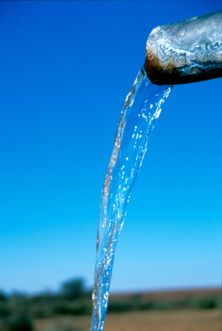
Aufbau und Inbetriebnahme eines Biokohle-/ Sandfilters für die nachgeschaltete Reinigung von kommunalem Abwasser
Drinking water treatment
with
ceramic filters
in Africa
Judith Krischler, Arjun Ajay, Maria Schulte
africaexpedition.de

Slide 2
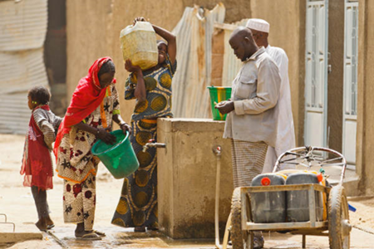
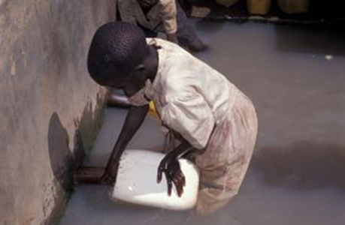
Aufbau und Inbetriebnahme eines Biokohle-/ Sandfilters für die nachgeschaltete Reinigung von kommunalem Abwasser
CIMNE International Center for Numerical Methods in Engineering
UPC Universitat Politècnica de Catalunya. BarcelonaTech
Why is that topic so important?
1.8 million people per year die because of diarrhea
88% due to unclean water and poor hygiene
344 million people in Africa did not have access to improved drinking water sources in 2010
WHO: avoidability of 94% of deaths with the help of improved safe water supply and sanitation
Solution: „point-of-use“- water treatment → e.g. ceramic filters
http://www.believeinzero.at
http://www.water-for-africa.org

Slide 3
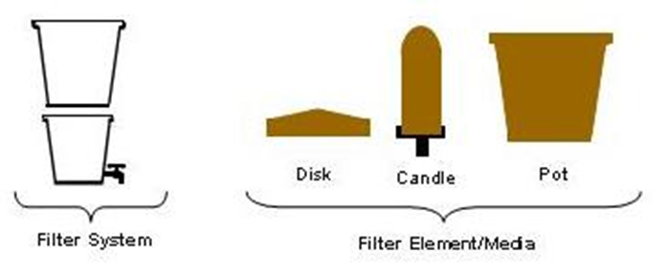
Aufbau und Inbetriebnahme eines Biokohle-/ Sandfilters für die nachgeschaltete Reinigung von kommunalem Abwasser
CIMNE International Center for Numerical Methods in Engineering
UPC Universitat Politècnica de Catalunya. BarcelonaTech
Manufacture of ceramic filters
Selection of materials:
clay, water, combustile materials (and possibly fire-resistant stones)
Mixing of materials:
Homogenous, not too moist mass
Forming the filter:
Disc filter
Pot filter
Candle filter
Drying and subsequent firing:
Burning temperature: 900-1000°C
(possibly new stones for oven necessary)
Dies, 2003

Slide 4
Aufbau und Inbetriebnahme eines Biokohle-/ Sandfilters für die nachgeschaltete Reinigung von kommunalem Abwasser
CIMNE International Center for Numerical Methods in Engineering
UPC Universitat Politècnica de Catalunya. BarcelonaTech
Advantages and disadvantages of ceramic filters
Advantages:
Economical and cheap in manufacturing and producing
Materials are readily available (sand, clay, sawdust, rice husks…)
In most countries ceramic trade is established
Necessary know-how for the production is available
High cleaning performance (with regard to microbial contamination and turbidity)
Disadvantages:
Partially slow flow rates (Ø 1 - 3 l/h)
Very fragile
Service life and reliability are user-dependent
→ difficult to ensure the durability
In poor countries there is often no high production rate

Slide 5
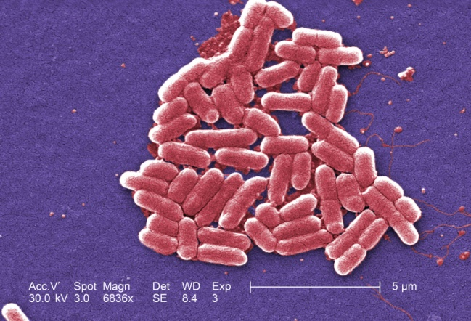
Aufbau und Inbetriebnahme eines Biokohle-/ Sandfilters für die nachgeschaltete Reinigung von kommunalem Abwasser
CIMNE International Center for Numerical Methods in Engineering
UPC Universitat Politècnica de Catalunya. BarcelonaTech
Guidelines and cleaning performance
WHO Guideline: E. coli should not be
in drinking water
E. coli: Indicator for fecal polluted water
Two studies in Cambodia:
blogs.britannica.com
Table 1: Cleaning performance of ceramic filters compared to biosand filters
 | Cleaning performance (%)
 | Ceramic filters | Biosand filters
Removal rate E. coli | 98 (up to 99,99) | 95
Reduction of diarrhea | 46 | 47
Reduction of water turbidity | 70 | 82

Slide 6
Aufbau und Inbetriebnahme eines Biokohle-/ Sandfilters für die nachgeschaltete Reinigung von kommunalem Abwasser
CIMNE International Center for Numerical Methods in Engineering
UPC Universitat Politècnica de Catalunya. BarcelonaTech
Guidelines and cleaning performance
WHO guidelines for risk groups
Assessment of sanitary situations due to infection risks
E. coli as the indicator bacteria
Likelihood of keeping the guideline at least
is higher for ceramic filters compared to biosand filter
africaexpedition.de
Table 2: Exceedance propability of the WHO guidelines
WHO risk groups by E. coli in drinking water | Exceedance propability (%)
 | Ceramic filters | Biosand filters
Low risk: >0CFU*/100ml | 30-40 | 56-67
Average risk: >10CFU*/100ml | 15 | 37
High risk: >100CFU*/100ml | 6 | 14
*CFU = colony-forming unit

Slide 7
Aufbau und Inbetriebnahme eines Biokohle-/ Sandfilters für die nachgeschaltete Reinigung von kommunalem Abwasser
CIMNE International Center for Numerical Methods in Engineering
UPC Universitat Politècnica de Catalunya. BarcelonaTech
Guidelines and cleaning performance
WHO: required reduction values for pathogens (dependent on DALY*)
Summary of average reduction values of sand and ceramic filters by the WHO
Table 3: required and average reduction values of household water treatment in LRV** (log₁₀ reduction value)
Patogens | Required LRV |  | Average LRV
 | Protective (≤10⁻⁴ DALY per person per year) | Highly Protective (≤10⁻⁶ DALY per person per year) | Ceramic filters | Slow sand filters
Bacteria | ≥2 | ≥4
Viruses | ≥3 | ≥5
Protozoa | ≥2 | ≥4
*DALY: Disability-adjusted life-years, measure for the health of a population or the burden of disease
**LRV = Log₁₀ (Pathogenic concentration before treatment) - Log₁₀ (Pathogenic concentration after treatment)
LRV = 1 = 10¹ = 90%, LRV = 2 = 10² = 99%, LRV = 3 = 10³ = 99,9% reduced pathogens.

Slide 8
Aufbau und Inbetriebnahme eines Biokohle-/ Sandfilters für die nachgeschaltete Reinigung von kommunalem Abwasser
CIMNE International Center for Numerical Methods in Engineering
UPC Universitat Politècnica de Catalunya. BarcelonaTech
Guidelines and cleaning performance
ceramic filters have better reduction performance of all pathogens
ceramic filters more likely attain the „Highly Protective“ reduction values
Table 3: required and average reduction values of household water treatment in LRV** (log₁₀ reduction value)
Patogens | Required LRV |  | Average LRV
 | Protective (≤10⁻⁴ DALY per person per year) | Highly Protective (≤10⁻⁶ DALY per person per year) | Ceramic filters | Slow sand filters
Bacteria | ≥2 | ≥4 | 2-6 | 1-3
Viruses | ≥3 | ≥5 | 1-4 | 0,5-2
Protozoa | ≥2 | ≥4 | 4-6 | 2-4
*DALY: Disability-adjusted life-years, measure for the health of a population or the burden of disease
**LRV = Log₁₀ (Pathogenic concentration before treatment) - Log₁₀ (Pathogenic concentration after treatment)
LRV = 1 = 10¹ = 90%, LRV = 2 = 10² = 99%, LRV = 3 = 10³ = 99,9% reduced pathogens.

Slide 9
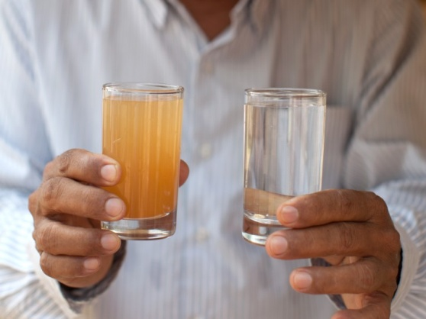
Aufbau und Inbetriebnahme eines Biokohle-/ Sandfilters für die nachgeschaltete Reinigung von kommunalem Abwasser
CIMNE International Center for Numerical Methods in Engineering
UPC Universitat Politècnica de Catalunya. BarcelonaTech
Ensuring drinking water demand
WHO statement: 20 liters of water per day and person for a minimum of health and hygiene
Ceramic filters: flow rate 1-3 l/h
→ 10 hours for 20 liters
Sand filters flow rate 15-60 l/h
Flow rate depending on filter thickness, the used material
and the thereof accompanying pore size of the filter
Connection between change in performance and service life not known
→ General: 4 years of use period, in which filter cleans smoothly
Filter cleaning by user is obligatory (due to particulate material)
charitywater.org

Slide 10
Aufbau und Inbetriebnahme eines Biokohle-/ Sandfilters für die nachgeschaltete Reinigung von kommunalem Abwasser
CIMNE International Center for Numerical Methods in Engineering
UPC Universitat Politècnica de Catalunya. BarcelonaTech
Summary
Africa: more than 30% of the population don‘t have access to improved drinking water → death by diarrhea is often the case
Potential solution: water cleaning at the point of use
→ Ceramic filters
Production possible on-site, cost-effective
High cleaning performance
WHO guidelines are more likely kept than with sand filters
Problem: slow provision of purified water, cleaning required by users
But: Many lives could be saved by this simple gadget.

Slide 11
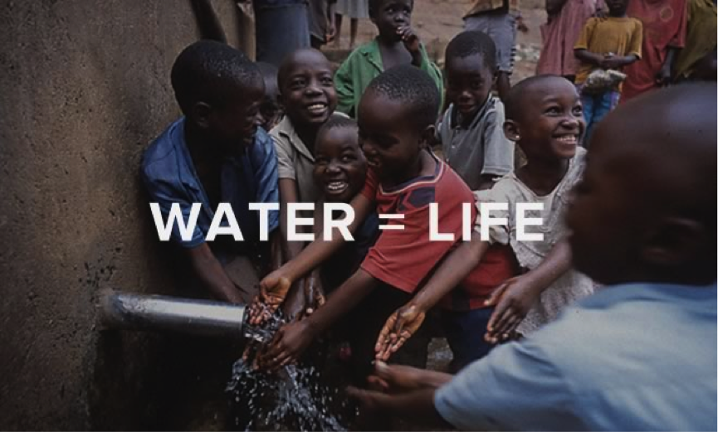
Aufbau und Inbetriebnahme eines Biokohle-/ Sandfilters für die nachgeschaltete Reinigung von kommunalem Abwasser
CIMNE International Center for Numerical Methods in Engineering
UPC Universitat Politècnica de Catalunya. BarcelonaTech
The end
Thank you for your attention!
globalnaturalresources.wordpress.com

